Slide 1

DOCTOR PAD
App - redesign - Solve a problem
Indira Konkasheva
19F_MTM6260_010
User Experience Design

Slide 2
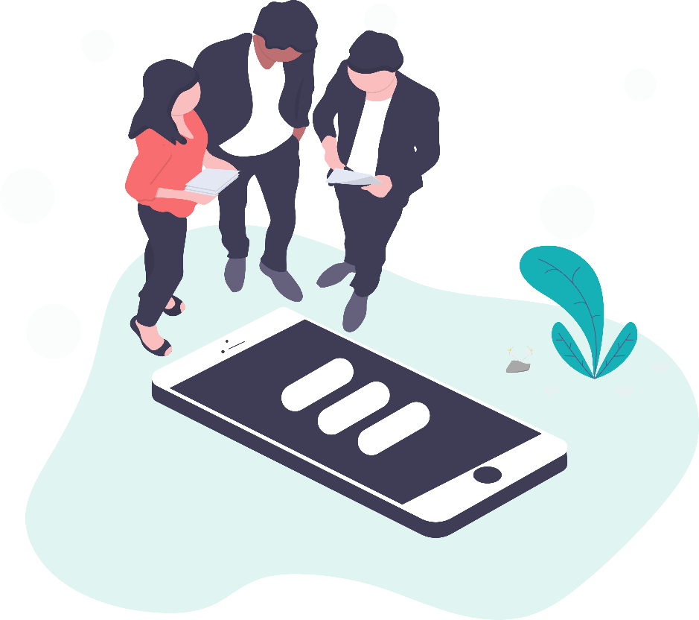
Business Goals
1
Increase the pool of clients
2
Raise the profit margin
3
Offer quality services
4
Become recognizable

Slide 3
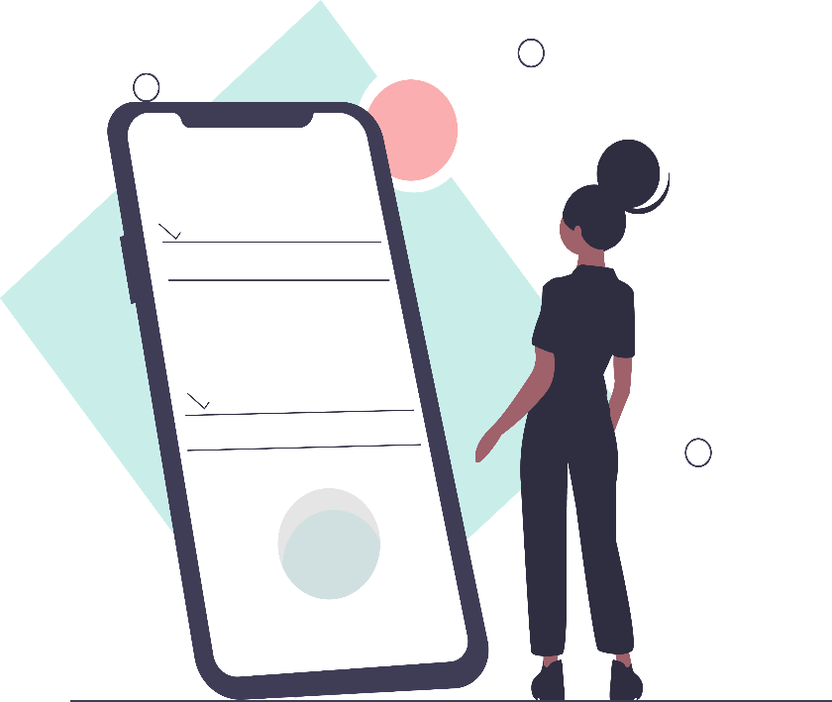
User Goals
1
Get quality service
2
Flexible graphic
3
Get diversified service in
one place/app
4
Payless and save time

Slide 4
Anna Smith
Status | Married | 3 kids | dog
Location | Ottawa | Ontario | Canada
General | 36 y/o | Extrovert | Likes read
Accountant
Anna is an accountant (IBM Company). Ever since she was a child, she loved to make stuff on her own and show them to her parents, friends and classmates. Over the course of her childhood and throughout her school, she won numerous prizes at various well-known competitions across the Canada. Due to her passion for Math, she decided to be an accountant.
Alan Moor
Status | Married | 3 kids | 2 dogs
Location | Toronto | Ontario | Canada
General | 54 y/o | Extrovert | Hardworking
Business Owner
Target Marketing Research
Alan Moor is an entrepreneur, investor. He founded the AFS Group in the 2015s. Moor expressed his desire to become an entrepreneur at a young age. His first business venture, at the age of 19, was a magazine called Music. He is married, has 3 kids. He reads a lot.
Fatima Kaur
Status | Single | n/a | 2 cats
Location | Ottawa | Ontario | Canada
General | 28 | introvert | Friendly
Dentist
Fatima Kaur is a leader of dentistry practice in Ottawa. She is an accredited laser dental instructor and trains many professionals using the BIOLASE laser system, one of the leading dental lasers used in the industry today. Fatima likes to read. She has 2 cats.

Slide 5
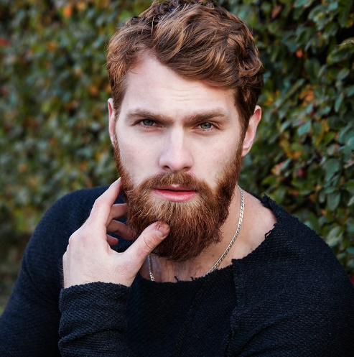
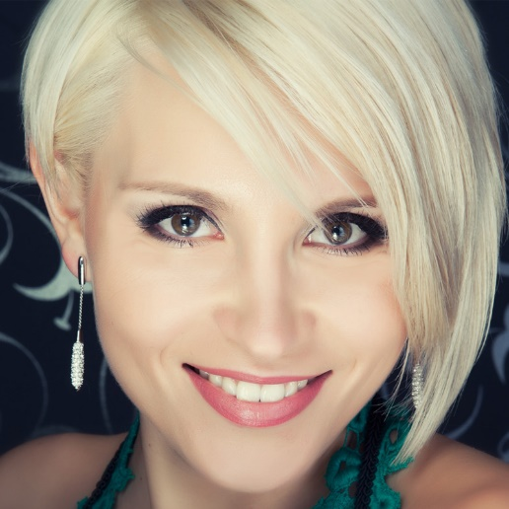
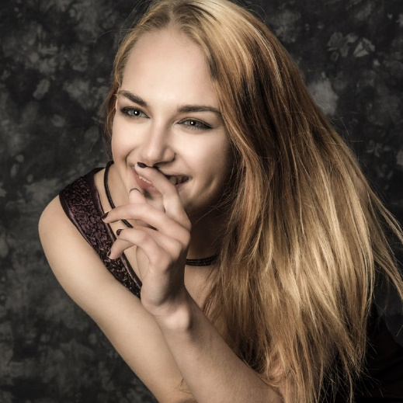



Personas
Alan Moor
Anna Smith
Fatima Kaur
Business Owner, 54
Accountant, 36
Dentist, 28
He needs a quality
annual examination
and medical service
She needs to have a
quality medical service for
her kids and parents
She is willing to take natural herbs instead of medication.
abcd@company.com
abcd@company.com
abcd@company.com
Facebook.com/abcd
Facebook.com/abcd
Facebook.com/abcd
Twiter.com/abcd
Twiter.com/abcd
Twiter.com/abcd

Slide 6
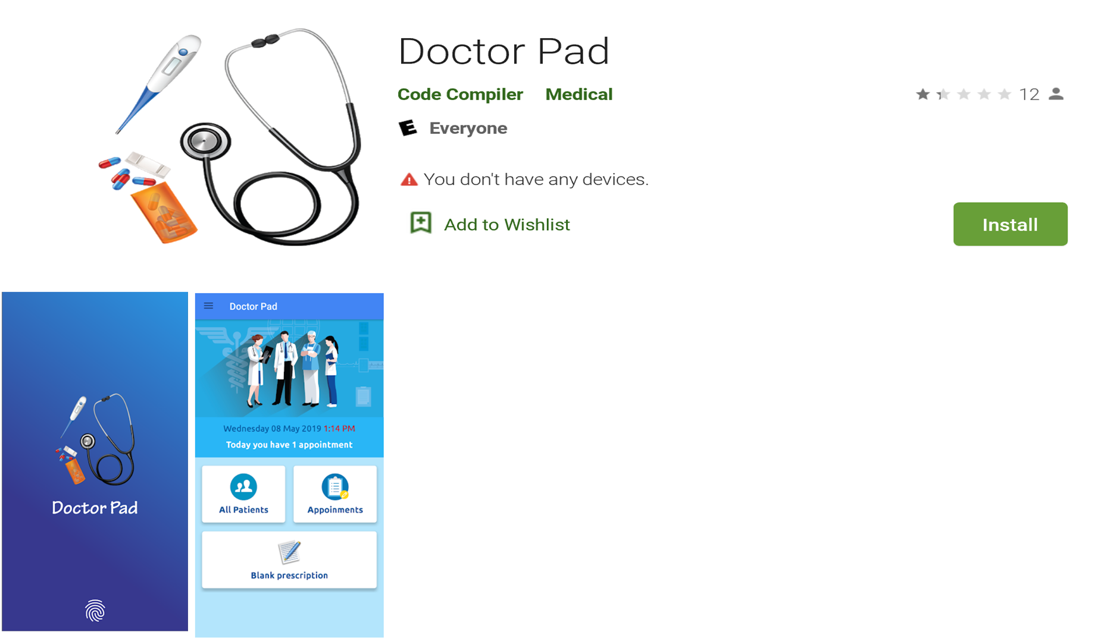
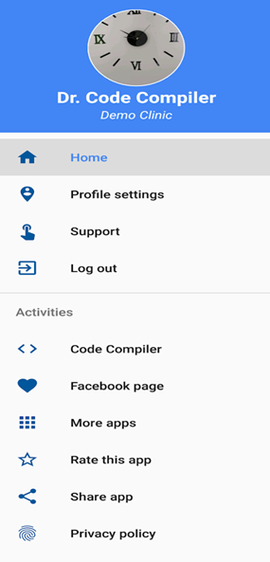
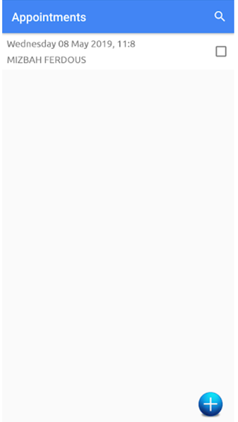
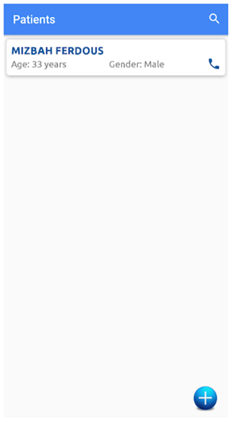
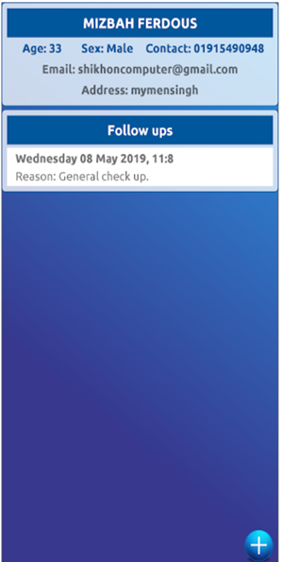
App-redesign (Original)

Slide 7
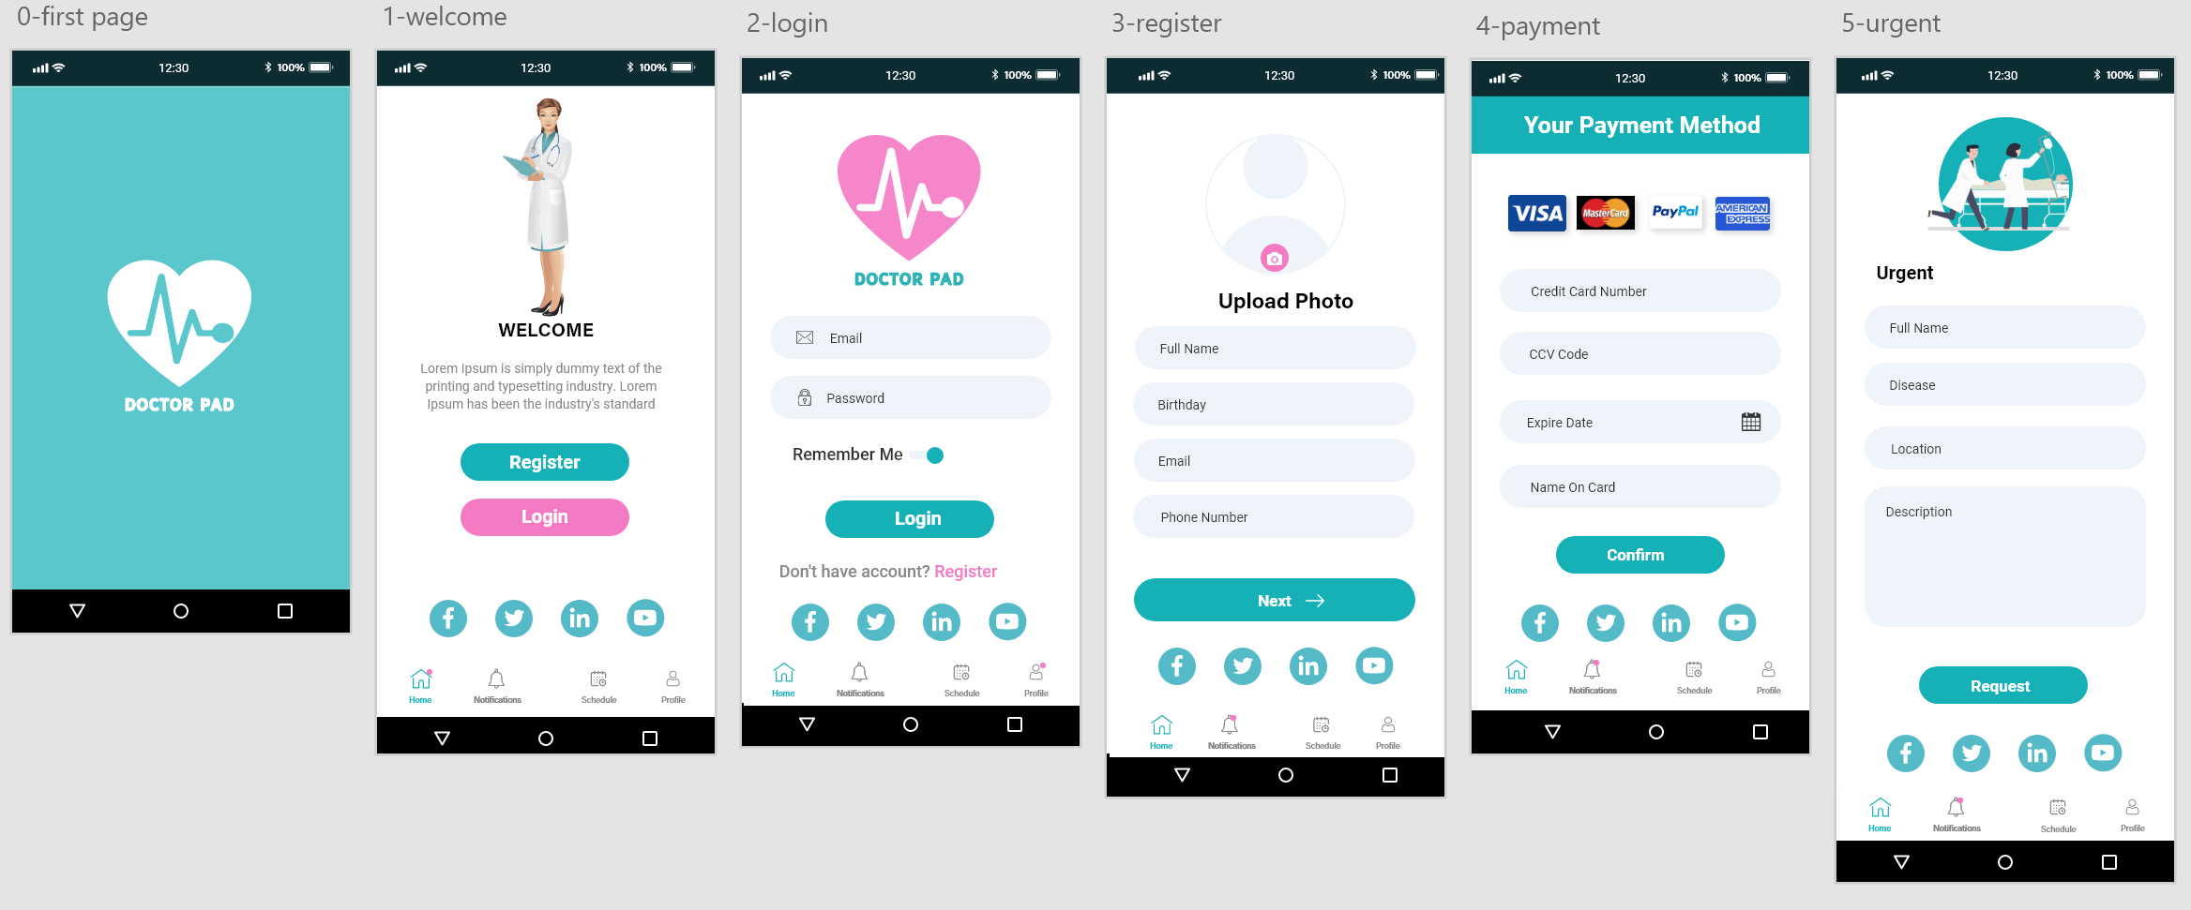
HIGH FIDELITY - PROTOTYPE
https://xd.adobe.com/view/15b5bcb1-5a12-4c49-7885-8d7643b7a78c-6384/
https://xd.adobe.com/view/37bf3729-8717-4edd-8d2a-332dbc7623af-62ec/

Slide 8
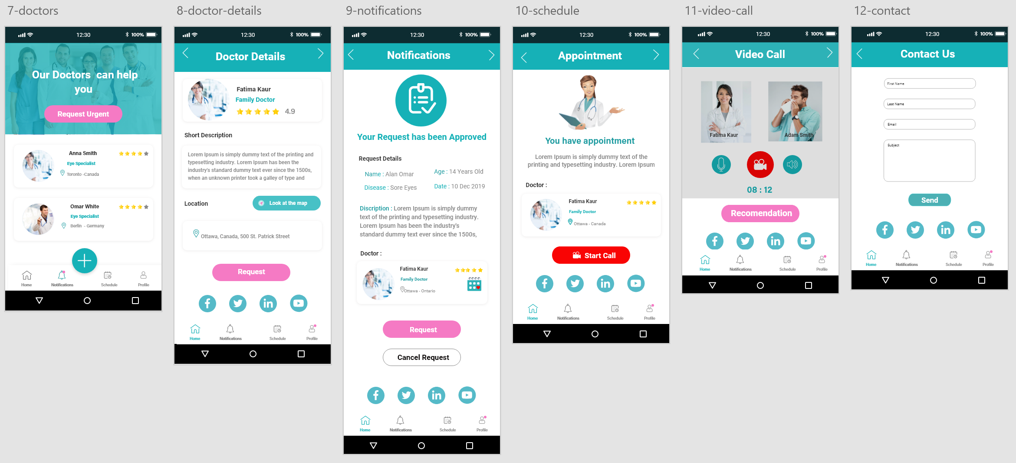
HIGH FIDELITY - PROTOTYPE
https://xd.adobe.com/view/37bf3729-8717-4edd-8d2a-332dbc7623af-62ec/

Slide 9
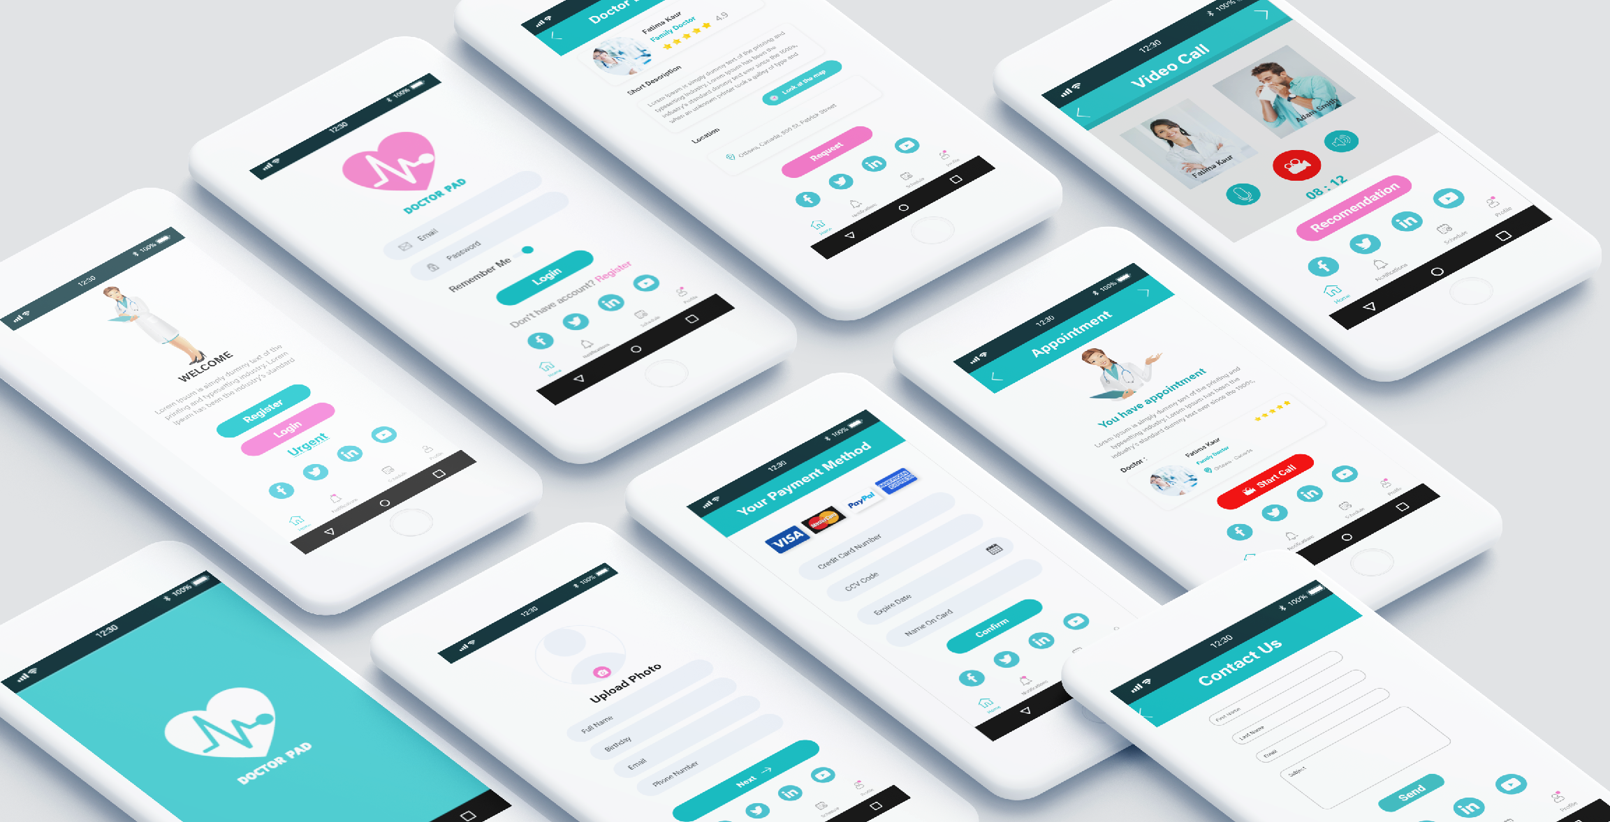
MOCK-UP

Slide 10

THANK YOU!
DOCTOR PAD

